Slide 1

Customer Shopping Behavior Analysis
Uncovering insights from transactional data to guide strategic business decisions

Slide 2

Project Overview
Goal
Data
Analyze 3,900 purchases to understand spending, segments, and preferences
Transactional data across various product categories
Outcome
Strategic insights for business decisions

Slide 3

Dataset Summary
Rows: 3,900
Columns: 18
Key Features:
Customer demographics (Age, Gender, Location, Subscription)
Purchase details (Item, Category, Amount, Season, Size, Color)
Shopping behavior (Discount, Promo, Previous Purchases, Frequency, Review, Shipping)
Missing Data: 37 values in Review Rating column

Slide 4

Exploratory Data Analysis (Python)
01
Data Preparation
Loading, initial exploration, and handling missing values
02
Standardization
Renamed columns to snake_case for readability
03
Feature Engineering
Created age_group and purchase_frequency_days
04
Database Integration
Loaded cleaned data into PostgreSQL for SQL analysis

Slide 5

Data Analysis (SQL)
1
Revenue by Gender
Female: $75,191 | Male: $157,890
2
High-Spending Discount Users
Identified 839 customers
3
Top 5 Products by Rating
Gloves, Sandals, Boots, Hat, Skirt
4
Shipping Type Comparison
Standard: $58.46 | Express: $60.48

Slide 6

SQL Insights: Subscriptions & Discounts
Subscribers vs. Non-Subscribers
Discount-Dependent Products
Yes
1053
$59.49
$62,645
Hat (50.00%)
Sneakers (49.66%)
No
2847
$59.87
$170,436
Coat (49.07%)
Sweater (48.17%)
Pants (47.37%)

Slide 7


Customer Segmentation
Loyal
New
3,116 customers
83 customers
Returning
701 customers

Slide 8

Top Products by Category
Accessories
Clothing
Footwear
Jewelry (171)
Blouse (171)
Sandals (160)
Sunglasses (161)
Pants (171)
Shoes (150)
Belt (161)
Shirt (169)
Sneakers (145)

Slide 9

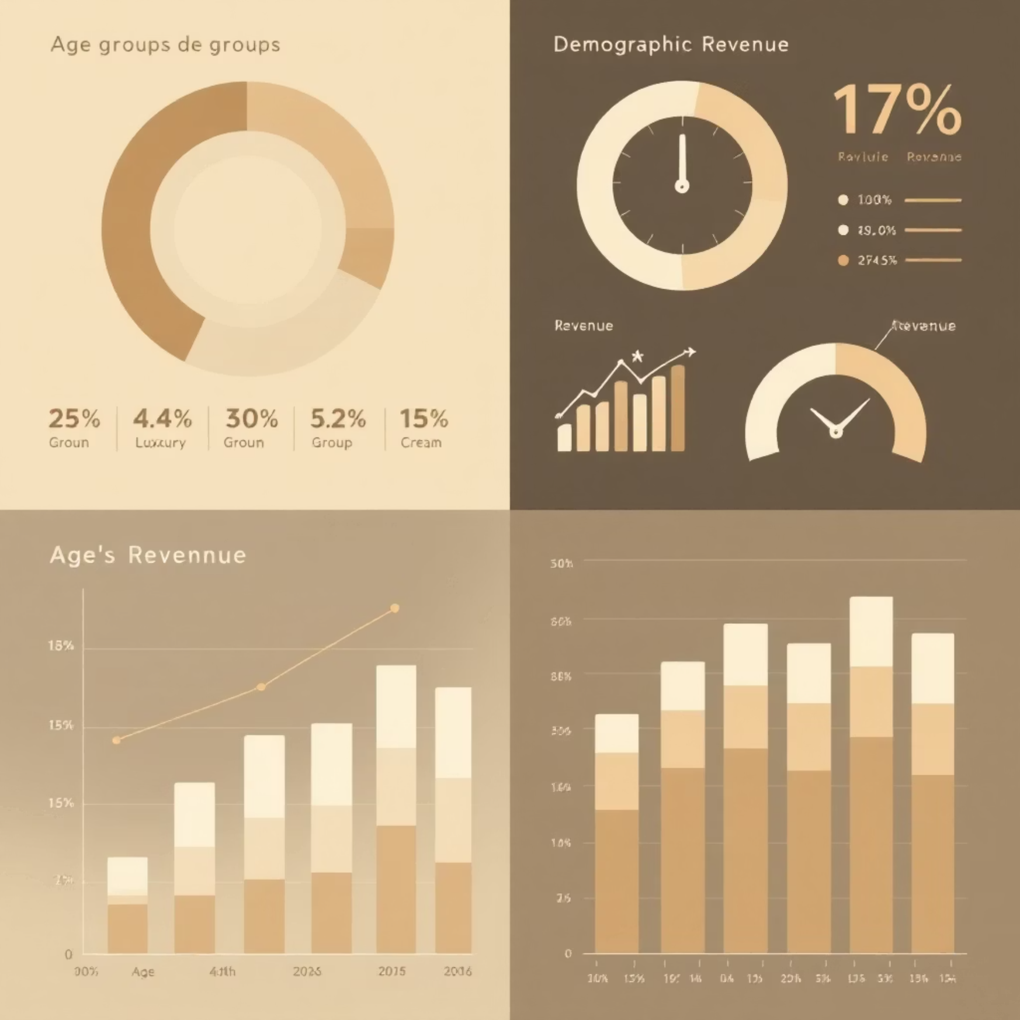
Age & Subscription Impact
Repeat Buyers & Subscriptions
Revenue by Age Group
Customers with >5 purchases:
Young Adult: $62,143
No Subscription: 2,518
Middle-aged: $59,197
Yes Subscription: 958
Adult: $55,978
Senior: $55,763

Slide 10
Business Recommendations
Boost Subscriptions
Promote exclusive benefits
Customer Loyalty
Reward repeat buyers
Review Discount Policy
Balance sales with margin control
Targeted Marketing
Focus on high-revenue age groups

